Slide 1
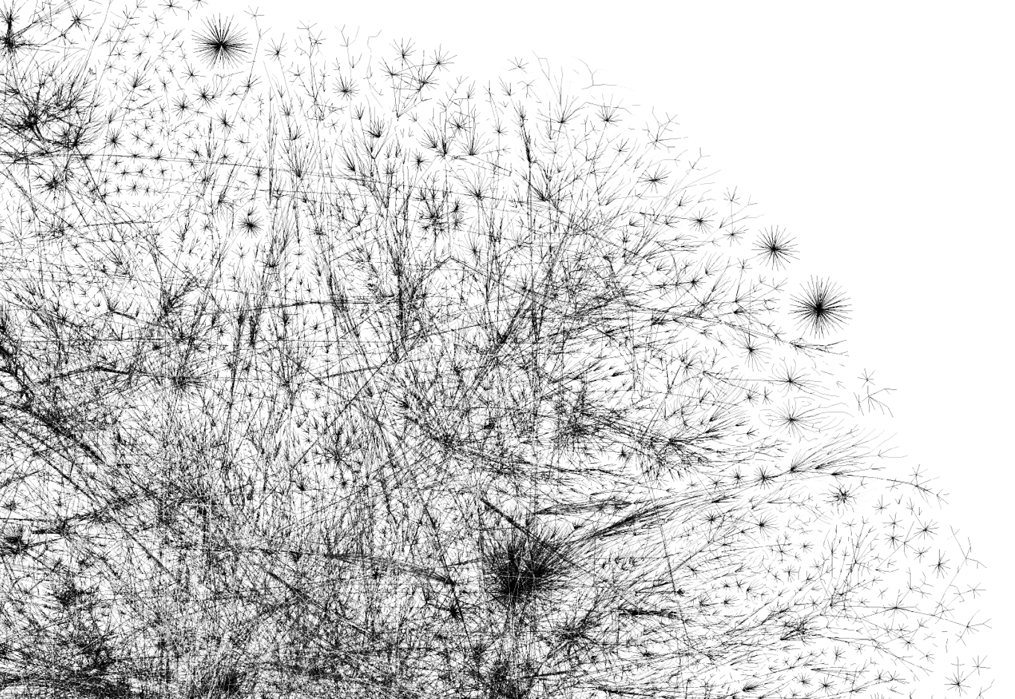
Graphs
CE-1103 Algorithms and Data Structures

Slide 2
Disclaimer / Descargo de Responsabilidad
Esta presentación corresponde a una guía usada por el profesor durante las clases. La misma ha sido modificada para ser utilizado en el modelo de cursos asistidos por tecnología. No es una versión final, por lo que la misma podría requerir todavía hacer algunos ajustes. Para aspectos de evaluación esta presentación es solo una guía, por lo que el estudiante debe profundizar con el material de lectura asignado y lo discutido en clases para aspectos de evaluación.
This presentation corresponds to a guide material used by the professor during classes. It has been modified to be used in the model of technology-assisted courses. It is not a final version, so it may still require some adjustments. For evaluation aspects, this presentation is only a guide, so the student should delve with the assigned reading material and what has been discussed in class.

Slide 3
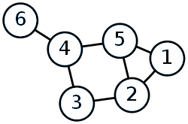
Introduction
Graphs are general data structures that have a wide range of applications:
Sociology
Chemistry
Geography
Electrical engineering
Industrial engineering

Slide 4
Introduction
Graphs are general data structures that have a wide range of applications:
Sociology
Chemistry
Geography
Electrical engineering
Industrial engineering
i.e Identify criminal networks

Slide 5
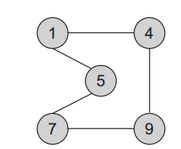
Concepts & definitions
A graph G groups together physical or conceptual entities. A graph is composed of:
Vertices, nodes or points that represents each of the entities
Edges, arcs or lines that represents relationships between nodes.
A graph is denoted as G = {V, A}

Slide 6
Concepts & definitions
A graph G groups together physical or conceptual entities. A graph is composed of:
Vertices, nodes or points that represents each of the entities
Edges, arcs or lines that represents relationships between nodes.
A graph is denoted as G = {V, A}
V = { 1, 4, 5, 7, 9 }

Slide 7
Concepts & definitions
A graph G groups together physical or conceptual entities. A graph is composed of:
Vertices, nodes or points that represents each of the entities
Edges, arcs or lines that represents relationships between nodes.
A graph is denoted as G = {V, A}
A = { (1,4), (4,1), (1,5), (5,1), (4,9), (9,4), (5,7),(7,5) (7,9),(9,7) }

Slide 8
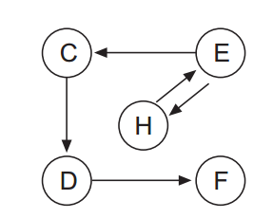
Concepts & definitions
A graph can be directed or undirected:
Undirected graph
Directed graph

Slide 9
Concepts & definitions
A graph can be directed or undirected:
Indicates the direction of the relationship
Undirected graph
Directed graph

Slide 10
Concepts & definitions
A graph can be directed or undirected:
Undirected graph
Directed graph
Vertices 7 and 9 are adjacent vertices

Slide 11
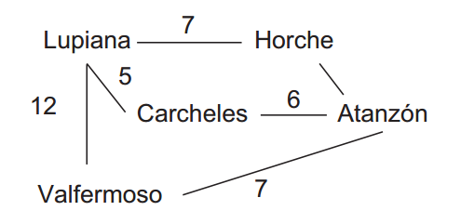
Concepts & definitions
An edge can have a weight associated denoting a magnitude associated with the relationship
Graphs with weight set on the edges are called weighted graphs
Weighted graph

Slide 12
Concepts & definitions
The degree of v is a quality of a node of a graph. In an undirected graph it is the number of edges that contains v
In a directed graph the indegree is the number of tail ends adjacent to v. Outdegree is the number of head ends adjacent to v

Slide 13
Concepts & definitions
A path P = (v₀, v₁, v₂, … , v_{n}) is a set of vertices that form the path from v₀ to v_{n}. v₀ and v_{n} can be the same.
It the vertices between v₀ to v_{n} are different, the path is called simple path

Slide 14
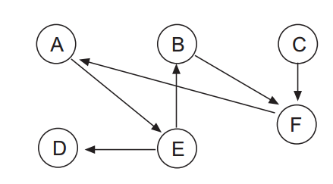
Concepts & definitions
A cycle is a simple path that begins and ends in the same node.
A DAG is a directed acyclic graph, a graph where there are no cycles

Slide 15
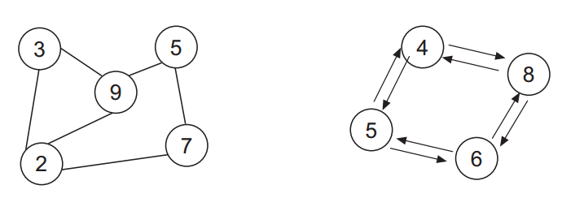
Concepts & definitions
A graph is connected if there is a path between any pair of nodes that compose it
A graph is strongly connected if the graph is connected and is a digraph

Slide 16
Graph representation
Graphs can be represented using two different approaches:
Using a bidimensional array known as adjacency matrix
Using a dynamic representation known as adjacency list
Choosing between one representation or the other depends of the type of the array and the operations that will be done

Slide 17
Graph representation
Graphs can be represented using two different approaches:
Using a bidimensional array known as adjacency matrix
Using a dynamic representation known as adjacency list
Choosing between one representation or the other depends of the type of the array and the operations that will be done
If the graph is dense (lots of arcs), is better to chose a matrix
If the graph is sparse, choose the linked list

Slide 18
Graph representation
Adjacency Matrix
Let G = {V, A} where V = {v₀, v₁, v₂, … , v_{n-1}} and A = {(vi, vj)}. Nodes can be represented by matrix A of nxn known as adjacency matrix. Each element of a_{ij} can take one of the following values:
0 if there is not an arc between (v_{i}, v_{j})
a_{ij}
1 if there is an arc between (v_{i}, v_{j})

Slide 19
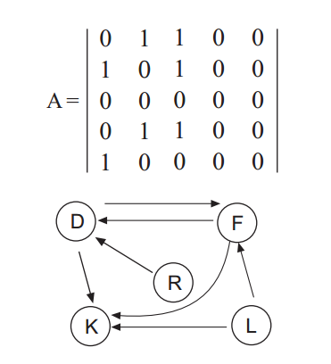
Graph representation
Adjacency Matrix
For example, let’s say the nodes are {D, F, K, L, R} the matrix will be:

Slide 20
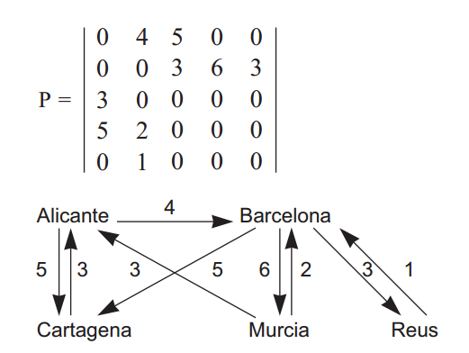
Graph representation
Adjacency Matrix
If the graph is weighted:

Slide 21
Graph representation
Adjacency List
An adjacency list is a linked list where each element represents a node of the graph. Each element contains a list of relationships with other nodes, being the element node, the origin

Slide 22
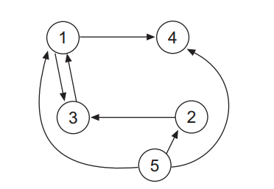
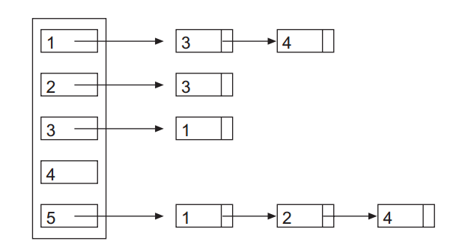
Graph representation
Adjacency List

Slide 23
Graph traversals
Traversing a graph involves visiting all reachable nodes starting from an specific node
Basic traversing algorithm:
Let V be the set of vertices of the graph
Let W be the set of not visited nodes. Initially it only contains the initial node v
Let Y be the set of visited nodes.
On each pass of the algorithm, removes a node w, get processed and for each edge of w, if not visited, will be added to w
Algorithm ends when W is empty

Slide 24
Graph traversals
Breadth-First
Uses a queue that keeps marked vertices
FIFO achieves that from v, all adjacent vertices are processed first, then all the adjacents of the adjacents of v...and so on

Slide 25
Graph traversals
Breadth-First
Algorithm:
Mark the start node v
Enqueue the start node v
Repeat step 4 and 5 until queue is empty
Dequeue node w from the queue, process w
Enqueue all adjacents nodes to w that are not marked, marked queued nodes
End

Slide 26
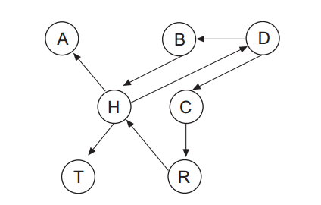
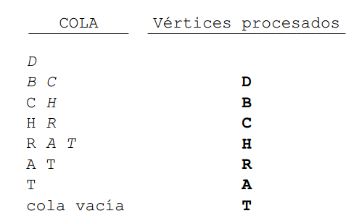
Graph traversals
Breadth-First
Queue
Visited
Empty Queue

Slide 27
Graph traversals
Depth-First
We saw that in the Breadth-First traversal, adjacents nodes are processed in a FIFO approach
In Depth-First, the processing order is given by a LIFO approach

Slide 28
Graph traversals
Depth-First
Traverse beings with a node v. v is marked as visited and pushed to the stack. Top of the stack is popped. Each unvisited adjacent node of v is pushed to the stack.
Continue until there are not more elements in the stack

Slide 29
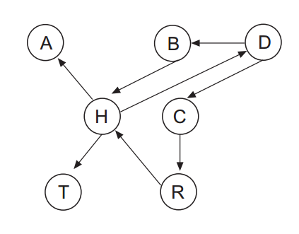
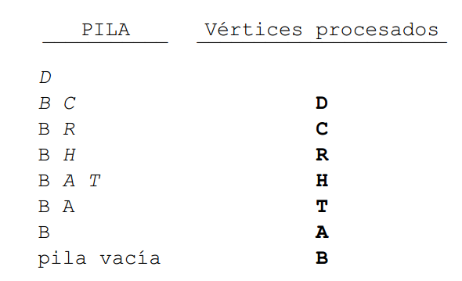
Graph traversals
Depth-First
Stack
Visited nodes
Empty Stack

Slide 30
Graph algorithms
Shortest-path: Dijkstra
One of the most common problems is to determine the shortest path between a pair of nodes
For this kind of problem we consider a directed and weighted graph
The length of the shortest path is the sum of the weight of each edge

Slide 31
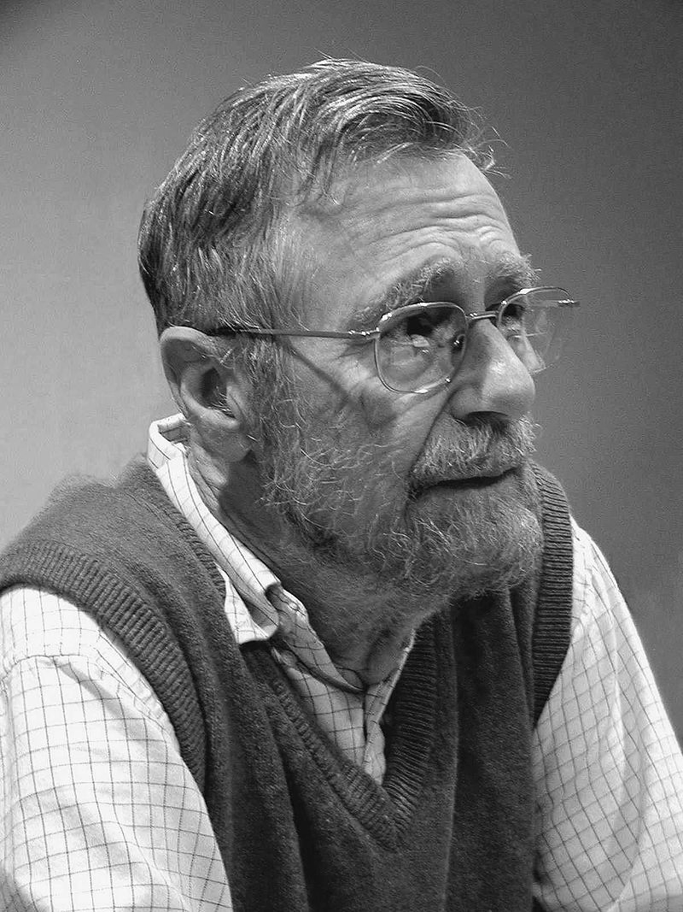
Graph algorithms
Shortest-path: Dijkstra
Dijkstra algorithm finds the shortest path from an origin node to all other nodes in a graph with positive weights
Edsger Dijkstra (1930 - 2002) was a Dutch computer scientist that shaped computer programming as a recognized science

Slide 32
Graph algorithms
Shortest-path: Dijkstra
Dijkstra algorithm is an avid algorithm that selects the best solution on each step
Let’s see how it works

Slide 33
Graph algorithms
Shortest-path: Dijkstra
a
5
c
6
e
v | a | b | c | d | e | f | g
5
6
7
3
2
2
3
b
d
f
g
2
9
1

Slide 34
Graph algorithms
Shortest-path: Dijkstra
a
5
c
6
e
v | a | b | c | d | e | f | g
5
6
7
3
2
2
3
b
d
f
g
2
9
1
Let’s find the shortest path from a to every other vertex

Slide 35
Graph algorithms
Shortest-path: Dijkstra
a
5
c
6
e
v | a | b | c | d | e | f | g
a | 0_{a} | 3_{a} | 5_{a} | 6_{a} | - | - | -
5
6
7
3
2
2
3
Sub index indicates the from node
b
d
f
g
2
9
1

Slide 36
Graph algorithms
Shortest-path: Dijkstra
a
5
c
6
e
v | a | b | c | d | e | f | g
a | 0_{a} | 3_{a} | 5_{a} | 6_{a} | - | - | -
5
6
7
3
2
2
3
b
d
f
g
Blue means: this is the shortest path. For example, from a to a, there won’t be other path shorter
2
9
1

Slide 37
Graph algorithms
Shortest-path: Dijkstra
a
5
c
6
e
v | a | b | c | d | e | f | g
a | 0_{a} | 3_{a} | 5_{a} | 6_{a} | - | - | -
Choose the lower one on this stage to continue. We already have a. So choose b
5
6
7
3
2
2
3
b
d
f
g
2
9
1

Slide 38
Graph algorithms
Shortest-path: Dijkstra
a
5
c
6
e
v | a | b | c | d | e | f | g
a | 0_{a} | 3_{a} | 5_{a} | 6_{a} | - | - | -
b | 0_{a} |  |  |  | - | - | -
5
6
7
3
2
2
3
We already knew that the shortest path to a was from a itself
b
d
f
g
2
9
1

Slide 39
Graph algorithms
Shortest-path: Dijkstra
a
5
c
6
e
v | a | b | c | d | e | f | g
a | 0_{a} | 3_{a} | 5_{a} | 6_{a} | - | - | -
b | 0_{a} |  |  |  | - | - | -
5
6
7
3
2
2
3
The shortest path to b from node a is?
b
d
f
g
2
9
1

Slide 40
Graph algorithms
Shortest-path: Dijkstra
a
5
c
6
e
v | a | b | c | d | e | f | g
a | 0_{a} | 3_{a} | 5_{a} | 6_{a} | - | - | -
b | 0_{a} | 3_{a} |  |  | - | - | -
5
6
7
3
2
2
3
b
d
f
g
2
9
1

Slide 41
Graph algorithms
Shortest-path: Dijkstra
a
5
c
6
e
v | a | b | c | d | e | f | g
a | 0_{a} | 3_{a} | 5_{a} | 6_{a} | - | - | -
b | 0_{a} | 3_{a} | 5_{a} | 5_{b} | - | - | -
5
6
7
3
2
2
3
b
d
f
g
To get to d from a we have two paths. Choose the lower one indicating the source node
2
9
1

Slide 42
Graph algorithms
Shortest-path: Dijkstra
a
5
c
6
e
v | a | b | c | d | e | f | g
a | 0_{a} | 3_{a} | 5_{a} | 6_{a} | - | - | -
b | 0_{a} | 3_{a} | 5_{a} | 5_{b} | - | - | -
c | 0_{a} | 3_{a} | 5_{a}
5
6
7
3
2
2
3
b
d
f
g
2
9
1

Slide 43
Graph algorithms
Shortest-path: Dijkstra
a
5
c
6
e
v | a | b | c | d | e | f | g
a | 0_{a} | 3_{a} | 5_{a} | 6_{a} | - | - | -
b | 0_{a} | 3_{a} | 5_{a} | 5_{b} | - | - | -
c | 0_{a} | 3_{a} | 5_{a} | 5_{b} | 11_{c} | 8_{c} | 12_{c}
5
6
7
3
2
2
3
b
d
f
g
2
9
1

Slide 44
Graph algorithms
Shortest-path: Dijkstra
a
5
c
6
e
v | a | b | c | d | e | f | g
a | 0_{a} | 3_{a} | 5_{a} | 6_{a} | - | - | -
b | 0_{a} | 3_{a} | 5_{a} | 5_{b} | - | - | -
c | 0_{a} | 3_{a} | 5_{a} | 5_{b} | 11_{c} | 8_{c} | 12_{c}
d | 0_{a} | 3_{a} | 5_{a} | 5_{b} | 11_{c} | 8_{c} | 12_{c}
f | 0_{a} | 3_{a} | 5_{a} | 5_{b} | 11_{c} | 8_{c} | 9_{f}
g
5
6
7
3
2
2
3
b
d
f
g
2
9
1
No further improvements...so we are done!

Slide 45
Graph algorithms
Shortest-path: Dijkstra
a
5
c
6
e
v | a | b | c | d | e | f | g
a | 0_{a} | 3_{a} | 5_{a} | 6_{a} | - | - | -
b | 0_{a} | 3_{a} | 5_{a} | 5_{b} | - | - | -
c | 0_{a} | 3_{a} | 5_{a} | 5_{b} | 11_{c} | 8_{c} | 12_{c}
d | 0_{a} | 3_{a} | 5_{a} | 5_{b} | 11_{c} | 8_{c} | 12_{c}
f | 0_{a} | 3_{a} | 5_{a} | 5_{b} | 11_{c} | 8_{c} | 9_{f}
5
6
7
3
2
2
3
b
d
f
g
2
9
1
What is the shortest path from a to g? a > c > f > g

Slide 46
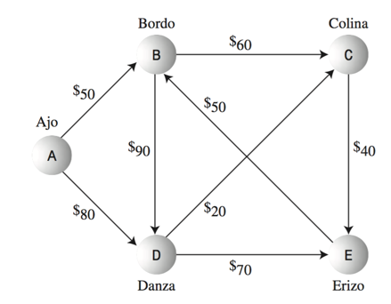
Graph algorithms
Shortest-path: Dijkstra
v | a | b | c | d | e
a | 0_{a} | 50_{a} | - | 80_{a} | -

Slide 47
Graph algorithms
Shortest-path: Dijkstra
v | a | b | c | d | e
a | 0_{a} | 50_{a} | - | 80_{a} | -

Slide 48
Graph algorithms
Shortest-path: Dijkstra
v | a | b | c | d | e
a | 0_{a} | 50_{a} | - | 80_{a} | -

Slide 49
Graph algorithms
Shortest-path: Dijkstra
v | a | b | c | d | e
a | 0_{a} | 50_{a} | - | 80_{a} | -
b | 0_{a} | 50_{a} | 110_{b} | 80_{a} | -
d | 0_{a} | 50_{a} | 100_{d} | 80_{a} | 150_{d}
c | 0_{a} | 50_{a} | 100_{d} | 80_{a} | 140_{c}

Slide 50
Graph algorithms
Shortest-path: Dijkstra
v | a | b | c | d | e
a | 0_{a} | 50_{a} | - | 80_{a} | -
b | 0_{a} | 50_{a} | 110_{b} | 80_{a} | -
d | 0_{a} | 50_{a} | 100_{d} | 80_{a} | 150_{d}
c | 0_{a} | 50_{a} | 100_{d} | 80_{a} | 140_{c}
What is the cheapest way to get from a to e?

Slide 51
Graph algorithms
Shortest-path: Dijkstra
v | a | b | c | d | e
a | 0_{a} | 50_{a} | - | 80_{a} | -
b | 0_{a} | 50_{a} | 110_{b} | 80_{a} | -
d | 0_{a} | 50_{a} | 100_{d} | 80_{a} | 150_{d}
c | 0_{a} | 50_{a} | 100_{d} | 80_{a} | 140_{c}

Slide 52
Graph algorithms
Shortest-path: Dijkstra
Foreach node set distance[node] = HIGH SettledNodes = empty UnSettledNodes = empty Add sourceNode to UnSettledNodes distance[sourceNode]= 0 while (UnSettledNodes is not empty) { evaluationNode = getNodeWithLowestDistance(UnSettledNodes) remove evaluationNode from UnSettledNodes add evaluationNode to SettledNodes evaluatedNeighbors(evaluationNode) } getNodeWithLowestDistance(UnSettledNodes){ find the node with the lowest distance in UnSettledNodes and return it } evaluatedNeighbors(evaluationNode){ Foreach destinationNode which can be reached via an edge from evaluationNode AND which is not in SettledNodes { edgeDistance = getDistance(edge(evaluationNode, destinationNode)) newDistance = distance[evaluationNode] + edgeDistance if (distance[destinationNode] > newDistance) { distance[destinationNode] = newDistance
evaluation.predecessor = evaluationNode add destinationNode to UnSettledNodes } } }

Slide 53
Graph algorithms
Shortest-path: Dijkstra

Slide 54
Graph algorithms
Shortest-path: Floyd-Warshall
How to calculate the shortest path from every node to every node?
Run Dijkstra from every node!
Yes but there is a more direct solution
Floyd algorithm calculates using dynamic programming the shortest path from every node to every node

Slide 55
Graph algorithms
Shortest-path: Floyd
Floyd algorithm represents the graph as a weighted matrix. Each arc (v_{i}, v_{j}) has a weight c_{ij}. If the arc does not exist, the value is ∞.
The diagonal of the matrix is equal to zero.

Slide 56
Graph algorithms
Shortest-path: Floyd
Floyd algorithm determines a new matrix D of n_{x}n elements, where each D_{ij} is the minimum path from v_{i} to v_{j}
A new matrix D₁, D₂, ... , D_{k}, D_{n} is generated on each step from D₀. On each step a new vertex is included to determine if that vertex improves the paths to become shorter

Slide 57
Graph algorithms
Shortest-path: Floyd
c_{ij} weight of the arc from vertex_{i} to vertex_{j}
D₀[i, j] =
∞ if there is no arc
D₁[i, j] = minimum(D₀[i,j],D₀[i,1]+D₀[1,j])
D₂[i, j] = minimum(D₁[i,j],D₁[i,2]+D₁[2,j])
D_{k}[i, j] = minimum(D_{k-1}[i,j],D_{k-1}[i,k]+D_{k-1}[k,j])

Slide 58
Graph algorithms
Shortest-path: Floyd
Another matrix Q₁, Q₂, ... , Q_{k}, Q_{n} is generated on each step from Q₀. Q is the predecessor matrix.

Slide 59
Graph algorithms
Shortest-path: Floyd
0 if i = j or D_{ij} = ∞
Q₀[i, j] =
i in all other cases
Q_{n-1}[i, j] if D_{n-1}[i,j] ≤ D_{n-1}[i,n]+D_{n-1}[n,j]
Q_{n}[i, j] =
Q_{n-1}[n, j] if D_{n-1}[i,j] > D_{n-1}[i,n]+D_{n-1}[n,j]

Slide 60
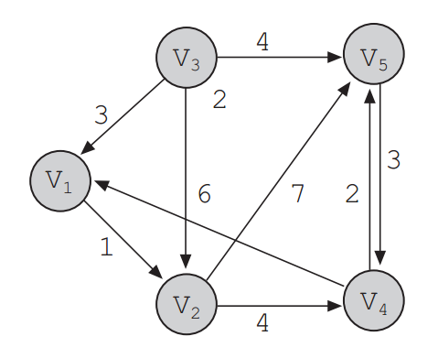
Graph algorithms
Shortest-path: Floyd
j
D₀ | V₁ | V₂ | V₃ | V₄ | V₅
V₁ | 0 | 1 | ∞ | ∞ | ∞
V₂ | ∞ | 0 | ∞ | 4 | 7
V₃ | 3 | 2 | 0 | ∞ | 4
V₄ | 6 | ∞ | ∞ | 0 | 2
V₅ | ∞ | ∞ | ∞ | 3 | 0
Q₀ | V₁ | V₂ | V₃ | V₄ | V₅
V₁ | 0 | 1 | 0 | 0 | 0
V₂ | 0 | 0 | 0 | 2 | 2
V₃ | 3 | 3 | 0 | 0 | 3
V₄ | 4 | 0 | 0 | 0 | 4
V₅ | 0 | 0 | 0 | 5 | 0
i
i
D_{k}[i, j] = minimum( D_{k-1}[i,j],
D_{k-1}[i,k]+
D_{k-1}[k,j])

Slide 61
Graph algorithms
Shortest-path: Floyd
j
D₀ | V₁ | V₂ | V₃ | V₄ | V₅
V₁ | 0 | 1 | ∞ | ∞ | ∞
V₂ | ∞ | 0 | ∞ | 4 | 7
V₃ | 3 | 2 | 0 | ∞ | 4
V₄ | 6 | ∞ | ∞ | 0 | 2
V₅ | ∞ | ∞ | ∞ | 3 | 0
Q₀ | V₁ | V₂ | V₃ | V₄ | V₅
V₁ | 0 | 1 | 0 | 0 | 0
V₂ | 0 | 0 | 0 | 2 | 2
V₃ | 3 | 3 | 0 | 0 | 3
V₄ | 4 | 0 | 0 | 0 | 4
V₅ | 0 | 0 | 0 | 5 | 0
i
i
D₁ | V₁ | V₂ | V₃ | V₄ | V₅
V₁ | 0
V₂
V₃
V₄
V₅
Q₁ | V₁ | V₂ | V₃ | V₄ | V₅
V₁ | 0
V₂
V₃
V₄
V₅
D_{k}[i, j] = minimum( D_{k-1}[i,j],
D_{k-1}[i,k]+
D_{k-1}[k,j])
i

Slide 62
Graph algorithms
Shortest-path: Floyd
j
D₀ | V₁ | V₂ | V₃ | V₄ | V₅
V₁ | 0 | 1 | ∞ | ∞ | ∞
V₂ | ∞ | 0 | ∞ | 4 | 7
V₃ | 3 | 2 | 0 | ∞ | 4
V₄ | 6 | ∞ | ∞ | 0 | 2
V₅ | ∞ | ∞ | ∞ | 3 | 0
Q₀ | V₁ | V₂ | V₃ | V₄ | V₅
V₁ | 0 | 1 | 0 | 0 | 0
V₂ | 0 | 0 | 0 | 2 | 2
V₃ | 3 | 3 | 0 | 0 | 3
V₄ | 4 | 0 | 0 | 0 | 4
V₅ | 0 | 0 | 0 | 5 | 0
min( D₀[1,2],D₀[1,1]+D₀[1,2])
i
D₁ | V₁ | V₂ | V₃ | V₄ | V₅
V₁ | 0 | 1
V₂
V₃
V₄
V₅
Q₁ | V₁ | V₂ | V₃ | V₄ | V₅
V₁ | 0 | 1 | 0 | 0 | 0
V₂
V₃
V₄
V₅
D_{k}[i, j] = minimum( D_{k-1}[i,j],
D_{k-1}[i,k]+
D_{k-1}[k,j])

Slide 63
Graph algorithms
Shortest-path: Floyd
j
D₀ | V₁ | V₂ | V₃ | V₄ | V₅
V₁ | 0 | 1 | ∞ | ∞ | ∞
V₂ | ∞ | 0 | ∞ | 4 | 7
V₃ | 3 | 2 | 0 | ∞ | 4
V₄ | 6 | ∞ | ∞ | 0 | 2
V₅ | ∞ | ∞ | ∞ | 3 | 0
Q₀ | V₁ | V₂ | V₃ | V₄ | V₅
V₁ | 0 | 1 | 0 | 0 | 0
V₂ | 0 | 0 | 0 | 2 | 2
V₃ | 3 | 3 | 0 | 0 | 3
V₄ | 4 | 0 | 0 | 0 | 4
V₅ | 0 | 0 | 0 | 5 | 0
j
min( D₀[2,1],D₀[2,1]+D₀[1,1])
i
D₁ | V₁ | V₂ | V₃ | V₄ | V₅
V₁ | 0 | 1 | ∞ | ∞ | ∞
V₂ | ∞
V₃
V₄
V₅
Q₁ | V₁ | V₂ | V₃ | V₄ | V₅
V₁ | 0 | 1 | 0 | 0 | 0
V₂ | 0
V₃
V₄
V₅
D_{k}[i, j] = minimum( D_{k-1}[i,j],
D_{k-1}[i,k]+
D_{k-1}[k,j])

Slide 64
Graph algorithms
Shortest-path: Floyd
j
D₀ | V₁ | V₂ | V₃ | V₄ | V₅
V₁ | 0 | 1 | ∞ | ∞ | ∞
V₂ | ∞ | 0 | ∞ | 4 | 7
V₃ | 3 | 2 | 0 | ∞ | 4
V₄ | 6 | ∞ | ∞ | 0 | 2
V₅ | ∞ | ∞ | ∞ | 3 | 0
Q₀ | V₁ | V₂ | V₃ | V₄ | V₅
V₁ | 0 | 1 | 0 | 0 | 0
V₂ | 0 | 0 | 0 | 2 | 2
V₃ | 3 | 3 | 0 | 0 | 3
V₄ | 4 | 0 | 0 | 0 | 4
V₅ | 0 | 0 | 0 | 5 | 0
j
min( D₀[2,2],D₀[2,1]+D₀[1,2])
i
D₁ | V₁ | V₂ | V₃ | V₄ | V₅
V₁ | 0 | 1 | ∞ | ∞ | ∞
V₂ | ∞ | 0
V₃
V₄
V₅
Q₁ | V₁ | V₂ | V₃ | V₄ | V₅
V₁ | 0 | 1 | 0 | 0 | 0
V₂ | 0 | 0
V₃
V₄
V₅
D_{k}[i, j] = minimum( D_{k-1}[i,j],
D_{k-1}[i,k]+
D_{k-1}[k,j])

Slide 65
Graph algorithms
Shortest-path: Floyd
j
D₀ | V₁ | V₂ | V₃ | V₄ | V₅
V₁ | 0 | 1 | ∞ | ∞ | ∞
V₂ | ∞ | 0 | ∞ | 4 | 7
V₃ | 3 | 2 | 0 | ∞ | 4
V₄ | 6 | ∞ | ∞ | 0 | 2
V₅ | ∞ | ∞ | ∞ | 3 | 0
Q₀ | V₁ | V₂ | V₃ | V₄ | V₅
V₁ | 0 | 1 | 0 | 0 | 0
V₂ | 0 | 0 | 0 | 2 | 2
V₃ | 3 | 3 | 0 | 0 | 3
V₄ | 4 | 0 | 0 | 0 | 4
V₅ | 0 | 0 | 0 | 5 | 0
j
min( D₀[2,3],D₀[2,1]+D₀[1,3])
i
D₁ | V₁ | V₂ | V₃ | V₄ | V₅
V₁ | 0 | 1 | ∞ | ∞ | ∞
V₂ | ∞ | 0 | ∞
V₃
V₄
V₅
Q₁ | V₁ | V₂ | V₃ | V₄ | V₅
V₁ | 0 | 1 | 0 | 0 | 0
V₂ | 0 | 0 | 0
V₃
V₄
V₅
D_{k}[i, j] = minimum( D_{k-1}[i,j],
D_{k-1}[i,k]+
D_{k-1}[k,j])

Slide 66
Graph algorithms
Shortest-path: Floyd
j
D₀ | V₁ | V₂ | V₃ | V₄ | V₅
V₁ | 0 | 1 | ∞ | ∞ | ∞
V₂ | ∞ | 0 | ∞ | 4 | 7
V₃ | 3 | 2 | 0 | ∞ | 4
V₄ | 6 | ∞ | ∞ | 0 | 2
V₅ | ∞ | ∞ | ∞ | 3 | 0
Q₀ | V₁ | V₂ | V₃ | V₄ | V₅
V₁ | 0 | 1 | 0 | 0 | 0
V₂ | 0 | 0 | 0 | 2 | 2
V₃ | 3 | 3 | 0 | 0 | 3
V₄ | 4 | 0 | 0 | 0 | 4
V₅ | 0 | 0 | 0 | 5 | 0
j
min( D₀[2,4],D₀[2,1]+D₀[1,4])
i
D₁ | V₁ | V₂ | V₃ | V₄ | V₅
V₁ | 0 | 1 | ∞ | ∞ | ∞
V₂ | ∞ | 0 | ∞ | 4
V₃
V₄
V₅
Q₁ | V₁ | V₂ | V₃ | V₄ | V₅
V₁ | 0 | 1 | 0 | 0 | 0
V₂ | 0 | 0 | 0 | 2
V₃
V₄
V₅
D_{k}[i, j] = minimum( D_{k-1}[i,j],
D_{k-1}[i,k]+
D_{k-1}[k,j])

Slide 67
Graph algorithms
Shortest-path: Floyd
j
D₀ | V₁ | V₂ | V₃ | V₄ | V₅
V₁ | 0 | 1 | ∞ | ∞ | ∞
V₂ | ∞ | 0 | ∞ | 4 | 7
V₃ | 3 | 2 | 0 | ∞ | 4
V₄ | 6 | ∞ | ∞ | 0 | 2
V₅ | ∞ | ∞ | ∞ | 3 | 0
Q₀ | V₁ | V₂ | V₃ | V₄ | V₅
V₁ | 0 | 1 | 0 | 0 | 0
V₂ | 0 | 0 | 0 | 2 | 2
V₃ | 3 | 3 | 0 | 0 | 3
V₄ | 4 | 0 | 0 | 0 | 4
V₅ | 0 | 0 | 0 | 5 | 0
j
min( D₀[2,5],D₀[2,1]+D₀[1,5])
i
D₁ | V₁ | V₂ | V₃ | V₄ | V₅
V₁ | 0 | 1 | ∞ | ∞ | ∞
V₂ | ∞ | 0 | ∞ | 4 | 7
V₃
V₄
V₅
Q₀ | V₁ | V₂ | V₃ | V₄ | V₅
V₁ | 0 | 1 | 0 | 0 | 0
V₂ | 0 | 0 | 0 | 2 | 2
V₃
V₄
V₅
D_{k}[i, j] = minimum( D_{k-1}[i,j],
D_{k-1}[i,k]+
D_{k-1}[k,j])

Slide 68
Graph algorithms
Shortest-path: Floyd
j
D₀ | V₁ | V₂ | V₃ | V₄ | V₅
V₁ | 0 | 1 | ∞ | ∞ | ∞
V₂ | ∞ | 0 | ∞ | 4 | 7
V₃ | 3 | 2 | 0 | ∞ | 4
V₄ | 6 | ∞ | ∞ | 0 | 2
V₅ | ∞ | ∞ | ∞ | 3 | 0
Q₀ | V₁ | V₂ | V₃ | V₄ | V₅
V₁ | 0 | 1 | 0 | 0 | 0
V₂ | 0 | 0 | 0 | 2 | 2
V₃ | 3 | 3 | 0 | 0 | 3
V₄ | 4 | 0 | 0 | 0 | 4
V₅ | 0 | 0 | 0 | 5 | 0
i
D₁ | V₁ | V₂ | V₃ | V₄ | V₅
V₁ | 0 | 1 | ∞ | ∞ | ∞
V₂ | ∞ | 0 | ∞ | 4 | 7
V₃ | 3
V₄
V₅
Q₁ | V₁ | V₂ | V₃ | V₄ | V₅
V₁ | 0 | 1 | 0 | 0 | 0
V₂ | 0 | 0 | 0 | 2 | 2
V₃ | 3
V₄
V₅
min( D₀[3,1],D₀[3,1]+D₀[1,1])
D_{k}[i, j] = minimum( D_{k-1}[i,j],
D_{k-1}[i,k]+
D_{k-1}[k,j])

Slide 69
Graph algorithms
Shortest-path: Floyd
j
D₀ | V₁ | V₂ | V₃ | V₄ | V₅
V₁ | 0 | 1 | ∞ | ∞ | ∞
V₂ | ∞ | 0 | ∞ | 4 | 7
V₃ | 3 | 2 | 0 | ∞ | 4
V₄ | 6 | ∞ | ∞ | 0 | 2
V₅ | ∞ | ∞ | ∞ | 3 | 0
Q₀ | V₁ | V₂ | V₃ | V₄ | V₅
V₁ | 0 | 1 | 0 | 0 | 0
V₂ | 0 | 0 | 0 | 2 | 2
V₃ | 3 | 3 | 0 | 0 | 3
V₄ | 4 | 0 | 0 | 0 | 4
V₅ | 0 | 0 | 0 | 5 | 0
i
D₁ | V₁ | V₂ | V₃ | V₄ | V₅
V₁ | 0 | 1 | ∞ | ∞ | ∞
V₂ | ∞ | 0 | ∞ | 4 | 7
V₃ | 3 | 2
V₄
V₅
Q₁ | V₁ | V₂ | V₃ | V₄ | V₅
V₁ | 0 | 1 | 0 | 0 | 0
V₂ | 0 | 0 | 0 | 2 | 2
V₃ | 3 | 3
V₄
V₅
min( D₀[3,2],D₀[3,1]+D₀[1,2])
D_{k}[i, j] = minimum( D_{k-1}[i,j],
D_{k-1}[i,k]+
D_{k-1}[k,j])

Slide 70
Graph algorithms
Shortest-path: Floyd
j
D₀ | V₁ | V₂ | V₃ | V₄ | V₅
V₁ | 0 | 1 | ∞ | ∞ | ∞
V₂ | ∞ | 0 | ∞ | 4 | 7
V₃ | 3 | 2 | 0 | ∞ | 4
V₄ | 6 | ∞ | ∞ | 0 | 2
V₅ | ∞ | ∞ | ∞ | 3 | 0
Q₀ | V₁ | V₂ | V₃ | V₄ | V₅
V₁ | 0 | 1 | 0 | 0 | 0
V₂ | 0 | 0 | 0 | 2 | 2
V₃ | 3 | 3 | 0 | 0 | 3
V₄ | 4 | 0 | 0 | 0 | 4
V₅ | 0 | 0 | 0 | 5 | 0
i
D₁ | V₁ | V₂ | V₃ | V₄ | V₅
V₁ | 0 | 1 | ∞ | ∞ | ∞
V₂ | ∞ | 0 | ∞ | 4 | 7
V₃ | 3 | 2
V₄
V₅
Q₁ | V₁ | V₂ | V₃ | V₄ | V₅
V₁ | 0 | 1 | 0 | 0 | 0
V₂ | 0 | 0 | 0 | 2 | 2
V₃ | 3 | 3
V₄
V₅
min( D₀[3,2],D₀[3,1]+D₀[1,2])
D_{k}[i, j] = minimum( D_{k-1}[i,j],
D_{k-1}[i,k]+
D_{k-1}[k,j])
See the idea?

Slide 71
Graph algorithms
Shortest-path: Floyd
j
D₀ | V₁ | V₂ | V₃ | V₄ | V₅
V₁ | 0 | 1 | ∞ | ∞ | ∞
V₂ | ∞ | 0 | ∞ | 4 | 7
V₃ | 3 | 2 | 0 | ∞ | 4
V₄ | 6 | ∞ | ∞ | 0 | 2
V₅ | ∞ | ∞ | ∞ | 3 | 0
Q₀ | V₁ | V₂ | V₃ | V₄ | V₅
V₁ | 0 | 1 | 0 | 0 | 0
V₂ | 0 | 0 | 0 | 2 | 2
V₃ | 3 | 3 | 0 | 0 | 3
V₄ | 4 | 0 | 0 | 0 | 4
V₅ | 0 | 0 | 0 | 5 | 0
What is cheaper to get to 2 from 3? Directly or passing to 1 first?
i
D₁ | V₁ | V₂ | V₃ | V₄ | V₅
V₁ | 0 | 1 | ∞ | ∞ | ∞
V₂ | ∞ | 0 | ∞ | 4 | 7
V₃ | 3 | 2
V₄
V₅
Q₁ | V₁ | V₂ | V₃ | V₄ | V₅
V₁ | 0 | 1 | 0 | 0 | 0
V₂ | 0 | 0 | 0 | 2 | 2
V₃ | 3 | 3
V₄
V₅
min( D₀[3,2],D₀[3,1]+D₀[1,2])
D_{k}[i, j] = minimum( D_{k-1}[i,j],
D_{k-1}[i,k]+
D_{k-1}[k,j])

Slide 72
Graph algorithms
Shortest-path: Floyd
j
D₀ | V₁ | V₂ | V₃ | V₄ | V₅
V₁ | 0 | 1 | ∞ | ∞ | ∞
V₂ | ∞ | 0 | ∞ | 4 | 7
V₃ | 3 | 2 | 0 | ∞ | 4
V₄ | 6 | ∞ | ∞ | 0 | 2
V₅ | ∞ | ∞ | ∞ | 3 | 0
Q₀ | V₁ | V₂ | V₃ | V₄ | V₅
V₁ | 0 | 1 | 0 | 0 | 0
V₂ | 0 | 0 | 0 | 2 | 2
V₃ | 3 | 3 | 0 | 0 | 3
V₄ | 4 | 0 | 0 | 0 | 4
V₅ | 0 | 0 | 0 | 5 | 0
i
D₁ | V₁ | V₂ | V₃ | V₄ | V₅
V₁ | 0 | 1 | ∞ | ∞ | ∞
V₂ | ∞ | 0 | ∞ | 4 | 7
V₃ | 3 | 2 | 0
V₄
V₅
Q₁ | V₁ | V₂ | V₃ | V₄ | V₅
V₁ | 0 | 1 | 0 | 0 | 0
V₂ | 0 | 0 | 0 | 2 | 2
V₃ | 3 | 3 | 0
V₄
V₅
min( D₀[3,3],D₀[3,1]+D₀[1,3])
D_{k}[i, j] = minimum( D_{k-1}[i,j],
D_{k-1}[i,k]+
D_{k-1}[k,j])

Slide 73
Graph algorithms
Shortest-path: Floyd
j
D₀ | V₁ | V₂ | V₃ | V₄ | V₅
V₁ | 0 | 1 | ∞ | ∞ | ∞
V₂ | ∞ | 0 | ∞ | 4 | 7
V₃ | 3 | 2 | 0 | ∞ | 4
V₄ | 6 | ∞ | ∞ | 0 | 2
V₅ | ∞ | ∞ | ∞ | 3 | 0
Q₀ | V₁ | V₂ | V₃ | V₄ | V₅
V₁ | 0 | 1 | 0 | 0 | 0
V₂ | 0 | 0 | 0 | 2 | 2
V₃ | 3 | 3 | 0 | 0 | 3
V₄ | 4 | 0 | 0 | 0 | 4
V₅ | 0 | 0 | 0 | 5 | 0
i
i
D₁ | V₁ | V₂ | V₃ | V₄ | V₅
V₁ | 0 | 1 | ∞ | ∞ | ∞
V₂ | ∞ | 0 | ∞ | 4 | 7
V₃ | 3 | 2 | 0 | ∞ | 4
V₄ | 6
V₅
Q₁ | V₁ | V₂ | V₃ | V₄ | V₅
V₁ | 0 | 1 | 0 | 0 | 0
V₂ | 0 | 0 | 0 | 2 | 2
V₃ | 3 | 3 | 0 | 0 | 3
V₄ | 4
V₅
D_{k}[i, j] = minimum( D_{k-1}[i,j],
D_{k-1}[i,k]+
D_{k-1}[k,j])
min( D₀[4,1],D₀[4,1]+D₀[1,1])

Slide 74
Graph algorithms
Shortest-path: Floyd
j
D₀ | V₁ | V₂ | V₃ | V₄ | V₅
V₁ | 0 | 1 | ∞ | ∞ | ∞
V₂ | ∞ | 0 | ∞ | 4 | 7
V₃ | 3 | 2 | 0 | ∞ | 4
V₄ | 6 | ∞ | ∞ | 0 | 2
V₅ | ∞ | ∞ | ∞ | 3 | 0
Q₀ | V₁ | V₂ | V₃ | V₄ | V₅
V₁ | 0 | 1 | 0 | 0 | 0
V₂ | 0 | 0 | 0 | 2 | 2
V₃ | 3 | 3 | 0 | 0 | 3
V₄ | 4 | 0 | 0 | 0 | 4
V₅ | 0 | 0 | 0 | 5 | 0
i
D₁ | V₁ | V₂ | V₃ | V₄ | V₅
V₁ | 0 | 1 | ∞ | ∞ | ∞
V₂ | ∞ | 0 | ∞ | 4 | 7
V₃ | 3 | 2 | 0 | ∞ | 4
V₄ | 6 | 7
V₅
Q₁ | V₁ | V₂ | V₃ | V₄ | V₅
V₁ | 0 | 1 | 0 | 0 | 0
V₂ | 0 | 0 | 0 | 2 | 2
V₃ | 3 | 3 | 0 | 0 | 3
V₄ | 4 | 1
V₅
D_{k}[i, j] = minimum( D_{k-1}[i,j],
D_{k-1}[i,k]+
D_{k-1}[k,j])
min( D₀[4,2],D₀[4,1]+D₀[1,2])

Slide 75
Graph algorithms
Shortest-path: Floyd
j
D₀ | V₁ | V₂ | V₃ | V₄ | V₅
V₁ | 0 | 1 | ∞ | ∞ | ∞
V₂ | ∞ | 0 | ∞ | 4 | 7
V₃ | 3 | 2 | 0 | ∞ | 4
V₄ | 6 | ∞ | ∞ | 0 | 2
V₅ | ∞ | ∞ | ∞ | 3 | 0
Q₀ | V₁ | V₂ | V₃ | V₄ | V₅
V₁ | 0 | 1 | 0 | 0 | 0
V₂ | 0 | 0 | 0 | 2 | 2
V₃ | 3 | 3 | 0 | 0 | 3
V₄ | 4 | 0 | 0 | 0 | 4
V₅ | 0 | 0 | 0 | 5 | 0
i
D₁ | V₁ | V₂ | V₃ | V₄ | V₅
V₁ | 0 | 1 | ∞ | ∞ | ∞
V₂ | ∞ | 0 | ∞ | 4 | 7
V₃ | 3 | 2 | 0 | ∞ | 4
V₄ | 6 | 7 | ∞ | 0 | 2
V₅ | ∞ | ∞ | ∞ | 3 | 0
Q₁ | V₁ | V₂ | V₃ | V₄ | V₅
V₁ | 0 | 1 | 0 | 0 | 0
V₂ | 0 | 0 | 0 | 2 | 2
V₃ | 3 | 3 | 0 | 0 | 3
V₄ | 4 | 1 | 0 | 0 | 4
V₅ | 0 | 0 | 0 | 5 | 0
D_{k}[i, j] = minimum( D_{k-1}[i,j],
D_{k-1}[i,k]+
D_{k-1}[k,j])

Slide 76
Graph algorithms
Shortest-path: Floyd
j
D₁ | V₁ | V₂ | V₃ | V₄ | V₅
V₁ | 0 | 1 | ∞ | ∞ | ∞
V₂ | ∞ | 0 | ∞ | 4 | 7
V₃ | 3 | 2 | 0 | ∞ | 4
V₄ | 6 | 7 | ∞ | 0 | 2
V₅ | ∞ | ∞ | ∞ | 3 | 0
Q₁ | V₁ | V₂ | V₃ | V₄ | V₅
V₁ | 0 | 1 | 0 | 0 | 0
V₂ | 0 | 0 | 0 | 2 | 2
V₃ | 3 | 3 | 0 | 0 | 3
V₄ | 4 | 1 | 4 | 0 | 4
V₅ | 0 | 0 | 0 | 5 | 0
min( D₁[1,2],D₁[1,2]+D₁[2,2])
i
j
D₂ | V₁ | V₂ | V₃ | V₄ | V₅
V₁ | 0 | 1
V₂ |  | 0
V₃ |  |  | 0
V₄ |  |  |  | 0
V₅ |  |  |  |  | 0
Q₂ | V₁ | V₂ | V₃ | V₄ | V₅
V₁ | 0 | 1
V₂
V₃
V₄
V₅
D_{k}[i, j] = minimum( D_{k-1}[i,j],
D_{k-1}[i,k]+
D_{k-1}[k,j])

Slide 77
Graph algorithms
Shortest-path: Floyd
j
D₁ | V₁ | V₂ | V₃ | V₄ | V₅
V₁ | 0 | 1 | ∞ | ∞ | ∞
V₂ | ∞ | 0 | ∞ | 4 | 7
V₃ | 3 | 2 | 0 | ∞ | 4
V₄ | 6 | 7 | ∞ | 0 | 2
V₅ | ∞ | ∞ | ∞ | 3 | 0
Q₁ | V₁ | V₂ | V₃ | V₄ | V₅
V₁ | 0 | 1 | 0 | 0 | 0
V₂ | 0 | 0 | 0 | 2 | 2
V₃ | 3 | 3 | 0 | 0 | 3
V₄ | 4 | 1 | 4 | 0 | 4
V₅ | 0 | 0 | 0 | 5 | 0
min( D₁[1,4],D₁[1,2]+D₁[2,4])
i
j
D₂ | V₁ | V₂ | V₃ | V₄ | V₅
V₁ | 0 | 1 | ∞ | 5
V₂ |  | 0
V₃ |  |  | 0
V₄ |  |  |  | 0
V₅ |  |  |  |  | 0
Q₂ | V₁ | V₂ | V₃ | V₄ | V₅
V₁ | 0 | 1 | 0 | 2
V₂
V₃
V₄
V₅
D_{k}[i, j] = minimum( D_{k-1}[i,j],
D_{k-1}[i,k]+
D_{k-1}[k,j])

Slide 78
Graph algorithms
Shortest-path: Floyd
j
D₁ | V₁ | V₂ | V₃ | V₄ | V₅
V₁ | 0 | 1 | ∞ | ∞ | ∞
V₂ | ∞ | 0 | ∞ | 4 | 7
V₃ | 3 | 2 | 0 | ∞ | 4
V₄ | 6 | 7 | ∞ | 0 | 2
V₅ | ∞ | ∞ | ∞ | 3 | 0
Q₁ | V₁ | V₂ | V₃ | V₄ | V₅
V₁ | 0 | 1 | 0 | 0 | 0
V₂ | 0 | 0 | 0 | 2 | 2
V₃ | 3 | 3 | 0 | 0 | 3
V₄ | 4 | 1 | 4 | 0 | 4
V₅ | 0 | 0 | 0 | 5 | 0
i
D₂ | V₁ | V₂ | V₃ | V₄ | V₅
V₁ | 0 | 1 | ∞ | 5 | 8
V₂ | ∞ | 0 | ∞ | 4 | 7
V₃ | 3 | 2 | 0 | 6 | 4
V₄ | 6 | 7 | ∞ | 0 | 2
V₅ | ∞ | ∞ | ∞ | 3 | 0
Q₂ | V₁ | V₂ | V₃ | V₄ | V₅
V₁ | 0 | 1 | 0 | 2 | 2
V₂ | 0 | 0 | 0 | 2 | 2
V₃ | 3 | 3 | 0 | 2 | 3
V₄ | 4 | 1 | 4 | 0 | 4
V₅ | 0 | 0 | 0 | 5 | 0
D_{k}[i, j] = minimum( D_{k-1}[i,j],
D_{k-1}[i,k]+
D_{k-1}[k,j])

Slide 79
Graph algorithms
Shortest-path: Floyd
j
D₂ | V₁ | V₂ | V₃ | V₄ | V₅
V₁ | 0 | 1 | ∞ | 5 | 8
V₂ | ∞ | 0 | ∞ | 4 | 7
V₃ | 3 | 2 | 0 | 6 | 4
V₄ | 6 | 7 | ∞ | 0 | 2
V₅ | ∞ | ∞ | ∞ | 3 | 0
Q₂ | V₁ | V₂ | V₃ | V₄ | V₅
V₁ | 0 | 1 | 0 | 2 | 0
V₂ | 0 | 0 | 0 | 2 | 2
V₃ | 3 | 3 | 0 | 2 | 3
V₄ | 4 | 1 | 4 | 0 | 4
V₅ | 0 | 0 | 0 | 5 | 0
i
D₃ | V₁ | V₂ | V₃ | V₄ | V₅
V₁ | 0 | 1 | ∞ | 5 | 8
V₂ | ∞ | 0 | ∞ | 4 | 7
V₃ | 3 | 2 | 0 | 6 | 4
V₄ | 6 | 7 | ∞ | 0 | 2
V₅ | ∞ | ∞ | ∞ | 3 | 0
Q₃ | V₁ | V₂ | V₃ | V₄ | V₅
V₁ | 0 | 1 | 0 | 2 | 0
V₂ | 0 | 0 | 0 | 2 | 2
V₃ | 3 | 3 | 0 | 2 | 3
V₄ | 4 | 1 | 4 | 0 | 4
V₅ | 0 | 0 | 0 | 5 | 0
D_{k}[i, j] = minimum( D_{k-1}[i,j],
D_{k-1}[i,k]+
D_{k-1}[k,j])

Slide 80
Graph algorithms
Shortest-path: Floyd
j
D₃ | V₁ | V₂ | V₃ | V₄ | V₅
V₁ | 0 | 1 | ∞ | 5 | 8
V₂ | ∞ | 0 | ∞ | 4 | 7
V₃ | 3 | 2 | 0 | 6 | 4
V₄ | 6 | 7 | ∞ | 0 | 2
V₅ | ∞ | ∞ | ∞ | 3 | 0
Q₃ | V₁ | V₂ | V₃ | V₄ | V₅
V₁ | 0 | 1 | 0 | 2 | 0
V₂ | 0 | 0 | 0 | 2 | 2
V₃ | 3 | 3 | 0 | 2 | 3
V₄ | 4 | 1 | 4 | 0 | 4
V₅ | 0 | 0 | 0 | 5 | 0
i
D₄ | V₁ | V₂ | V₃ | V₄ | V₅
V₁ | 0 | 1 | ∞ | 5 | 7
V₂ | 10 | 0 | ∞ | 4 | 6
V₃ | 3 | 2 | 0 | 6 | 4
V₄ | 6 | 7 | ∞ | 0 | 2
V₅ | 9 | 10 | ∞ | 3 | 0
Q₄ | V₁ | V₂ | V₃ | V₄ | V₅
V₁ | 0 | 1 | 0 | 2 | 4
V₂ | 4 | 0 | 0 | 2 | 4
V₃ | 3 | 3 | 0 | 2 | 3
V₄ | 4 | 1 | 4 | 0 | 4
V₅ | 4 | 4 | 0 | 5 | 0
D_{k}[i, j] = minimum( D_{k-1}[i,j],
D_{k-1}[i,k]+
D_{k-1}[k,j])

Slide 81
Graph algorithms
Shortest-path: Floyd
j
D₄ | V₁ | V₂ | V₃ | V₄ | V₅
V₁ | 0 | 1 | ∞ | 5 | 7
V₂ | 10 | 0 | ∞ | 4 | 6
V₃ | 3 | 2 | 0 | 6 | 4
V₄ | 6 | 7 | ∞ | 0 | 2
V₅ | 9 | 10 | ∞ | 3 | 0
Q₄ | V₁ | V₂ | V₃ | V₄ | V₅
V₁ | 0 | 1 | 0 | 2 | 4
V₂ | 4 | 0 | 0 | 2 | 4
V₃ | 3 | 3 | 0 | 0 | 3
V₄ | 4 | 1 | 4 | 0 | 4
V₅ | 4 | 4 | 0 | 5 | 0
i
D₅ | V₁ | V₂ | V₃ | V₄ | V₅
V₁ | 0 | 1 | ∞ | 5 | 7
V₂ | 10 | 0 | ∞ | 4 | 6
V₃ | 3 | 2 | 0 | 6 | 4
V₄ | 6 | 7 | ∞ | 0 | 2
V₅ | 9 | 10 | ∞ | 3 | 0
Q₅ | V₁ | V₂ | V₃ | V₄ | V₅
V₁ | 0 | 1 | 0 | 2 | 4
V₂ | 4 | 0 | 0 | 2 | 4
V₃ | 3 | 3 | 0 | 2 | 3
V₄ | 4 | 1 | 4 | 0 | 4
V₅ | 4 | 4 | 0 | 5 | 0
D_{k}[i, j] = minimum( D_{k-1}[i,j],
D_{k-1}[i,k]+
D_{k-1}[k,j])

Slide 82
Graph algorithms
Shortest-path: Floyd
j
D₄ | V₁ | V₂ | V₃ | V₄ | V₅
V₁ | 0 | 1 | ∞ | 5 | 7
V₂ | 10 | 0 | ∞ | 4 | 6
V₃ | 3 | 2 | 0 | 6 | 4
V₄ | 6 | 7 | ∞ | 0 | 2
V₅ | 9 | 10 | ∞ | 3 | 0
Q₄ | V₁ | V₂ | V₃ | V₄ | V₅
V₁ | 0 | 1 | 0 | 2 | 4
V₂ | 4 | 0 | 0 | 2 | 4
V₃ | 3 | 3 | 0 | 0 | 3
V₄ | 4 | 1 | 4 | 0 | 4
V₅ | 4 | 4 | 0 | 5 | 0
i
D₅ | V₁ | V₂ | V₃ | V₄ | V₅
V₁ | 0 | 1 | ∞ | 5 | 7
V₂ | 10 | 0 | ∞ | 4 | 6
V₃ | 3 | 2 | 0 | 6 | 4
V₄ | 6 | 7 | ∞ | 0 | 2
V₅ | 9 | 10 | ∞ | 3 | 0
Q₅ | V₁ | V₂ | V₃ | V₄ | V₅
V₁ | 0 | 1 | 0 | 2 | 4
V₂ | 4 | 0 | 0 | 2 | 4
V₃ | 3 | 3 | 0 | 0 | 3
V₄ | 4 | 1 | 4 | 0 | 4
V₅ | 4 | 4 | 0 | 5 | 0
D_{k}[i, j] = minimum( D_{k-1}[i,j],
D_{k-1}[i,k]+
D_{k-1}[k,j])
What’s the shortest path from v₁ to v₄?

Slide 83
Graph algorithms
Shortest-path: Floyd
j
j
D₄ | V₁ | V₂ | V₃ | V₄ | V₅
V₁ | 0 | 1 | ∞ | 5 | 7
V₂ | 10 | 0 | ∞ | 4 | 6
V₃ | 3 | 2 | 0 | 6 | 4
V₄ | 6 | 7 | ∞ | 0 | 2
V₅ | 9 | 10 | ∞ | 3 | 0
Q₄ | V₁ | V₂ | V₃ | V₄ | V₅
V₁ | 0 | 1 | 0 | 2 | 4
V₂ | 4 | 0 | 0 | 2 | 4
V₃ | 3 | 3 | 0 | 0 | 3
V₄ | 4 | 1 | 4 | 0 | 4
V₅ | 4 | 4 | 0 | 5 | 0
i
i
j
D₅ | V₁ | V₂ | V₃ | V₄ | V₅
V₁ | 0 | 1 | ∞ | 5 | 7
V₂ | 10 | 0 | ∞ | 4 | 6
V₃ | 3 | 2 | 0 | 6 | 4
V₄ | 6 | 7 | ∞ | 0 | 2
V₅ | 9 | 10 | ∞ | 3 | 0
Q₅ | V₁ | V₂ | V₃ | V₄ | V₅
V₁ | 0 | 1 | 0 | 2 | 4
V₂ | 4 | 0 | 0 | 2 | 4
V₃ | 3 | 3 | 0 | 0 | 3
V₄ | 4 | 1 | 4 | 0 | 4
V₅ | 4 | 4 | 0 | 5 | 0
D_{k}[i, j] = minimum( D_{k-1}[i,j],
D_{k-1}[i,k]+
D_{k-1}[k,j])
i
What’s the shortest path from v₁ to v₄?

Slide 84
Graph algorithms
Shortest-path: Floyd
j
j
D₄ | V₁ | V₂ | V₃ | V₄ | V₅
V₁ | 0 | 1 | ∞ | 5 | 7
V₂ | 10 | 0 | ∞ | 4 | 7
V₃ | 3 | 2 | 0 | 6 | 6
V₄ | 6 | 7 | ∞ | 0 | 2
V₅ | 9 | 10 | ∞ | 3 | 0
Q₄ | V₁ | V₂ | V₃ | V₄ | V₅
V₁ | 0 | 1 | 0 | 2 | 4
V₂ | 4 | 0 | 0 | 2 | 4
V₃ | 3 | 3 | 0 | 0 | 3
V₄ | 4 | 1 | 4 | 0 | 4
V₅ | 4 | 4 | 0 | 5 | 0
i
i
j
D₅ | V₁ | V₂ | V₃ | V₄ | V₅
V₁ | 0 | 1 | ∞ | 5 | 7
V₂ | 10 | 0 | ∞ | 4 | 6
V₃ | 3 | 2 | 0 | 6 | 4
V₄ | 6 | 7 | ∞ | 0 | 2
V₅ | 9 | 10 | ∞ | 3 | 0
Q₅ | V₁ | V₂ | V₃ | V₄ | V₅
V₁ | 0 | 1 | 0 | 2 | 4
V₂ | 4 | 0 | 0 | 2 | 4
V₃ | 3 | 3 | 0 | 0 | 3
V₄ | 4 | 1 | 4 | 0 | 4
V₅ | 4 | 4 | 0 | 5 | 0
D_{k}[i, j] = minimum( D_{k-1}[i,j],
D_{k-1}[i,k]+
D_{k-1}[k,j])
i
What’s the shortest path from v₁ to v₄? R/{v₁,v₂,v₄}

Slide 85
Graph algorithms
Warshall
Calculates the path matrix P (also called transitive closure) of a graph G of n vertices, represented by its adjacency matrix A.
Defines a sequence of matrices n_{x}n P₀, P₁, P₂, P₃, … P_{n}
Similar to Floyd algorithm

Slide 86
Graph algorithms
Warshall
1 if there is an arc from v_{i} to v_{j}
P₀[i, j] =
0 if there is no arc
1 if there is an arc from v_{i} to v_{j} that does not go through other vertex different of v₁
P₁[i, j] =
0 if there is no arc
1 if there is an arc from v_{i} to v_{j} that does not go through other vertex different of v₁ … v₂
P₂[i, j] =
0 if there is no arc
1 if there is an arc from v_{i} to v_{j} that does not go through other vertex different of v₁ … v_{n}
P_{n}[i, j] =
0 if there is no arc

Slide 87
Graph algorithms
Warshall
j
P₀ | V₁ | V₂ | V₃ | V₄ | V₅
V₁ | 1 | 1 | 0 | 0 | 0
V₂ | 0 | 1 | 0 | 1 | 1
V₃ | 1 | 1 | 1 | 0 | 1
V₄ | 1 | 0 | 0 | 1 | 1
V₅ | 0 | 0 | 0 | 1 | 1
P₁ | V₁ | V₂ | V₃ | V₄ | V₅
V₁ | 1 | 1 | 0 | 0 | 0
V₂ | 0 | 1 | 0 | 1 | 1
V₃ | 1 | 1 | 1 | 0 | 1
V₄ | 1 | 1 | 0 | 1 | 1
V₅ | 0 | 0 | 0 | 1 | 1
i
P₂ | V₁ | V₂ | V₃ | V₄ | V₅
V₁ | 1 | 1 | 0 | 1 | 1
V₂ | 0 | 1 | 0 | 1 | 1
V₃ | 1 | 1 | 1 | 1 | 1
V₄ | 1 | 1 | 0 | 1 | 1
V₅ | 0 | 0 | 0 | 1 | 1
P₃ | V₁ | V₂ | V₃ | V₄ | V₅
V₁ | 1 | 1 | 0 | 1 | 1
V₂ | 0 | 1 | 0 | 1 | 1
V₃ | 1 | 1 | 1 | 1 | 1
V₄ | 1 | 1 | 0 | 1 | 1
V₅ | 0 | 0 | 0 | 1 | 1

Slide 88
Graph algorithms
Warshall
j
P₂ | V₁ | V₂ | V₃ | V₄ | V₅
V₁ | 1 | 1 | 0 | 1 | 1
V₂ | 0 | 1 | 0 | 1 | 1
V₃ | 1 | 1 | 1 | 1 | 1
V₄ | 1 | 1 | 0 | 1 | 1
V₅ | 0 | 0 | 0 | 1 | 1
P₃ | V₁ | V₂ | V₃ | V₄ | V₅
V₁ | 1 | 1 | 0 | 1 | 1
V₂ | 0 | 1 | 0 | 1 | 1
V₃ | 1 | 1 | 1 | 1 | 1
V₄ | 1 | 1 | 0 | 1 | 1
V₅ | 0 | 0 | 0 | 1 | 1
i
P₄ | V₁ | V₂ | V₃ | V₄ | V₅
V₁ | 1 | 1 | 0 | 1 | 1
V₂ | 1 | 1 | 0 | 1 | 1
V₃ | 1 | 1 | 1 | 1 | 1
V₄ | 1 | 1 | 0 | 1 | 1
V₅ | 1 | 1 | 0 | 1 | 1
P₅ | V₁ | V₂ | V₃ | V₄ | V₅
V₁ | 1 | 1 | 0 | 1 | 1
V₂ | 1 | 1 | 0 | 1 | 1
V₃ | 1 | 1 | 1 | 1 | 1
V₄ | 1 | 1 | 0 | 1 | 1
V₅ | 1 | 1 | 0 | 1 | 1

Slide 89
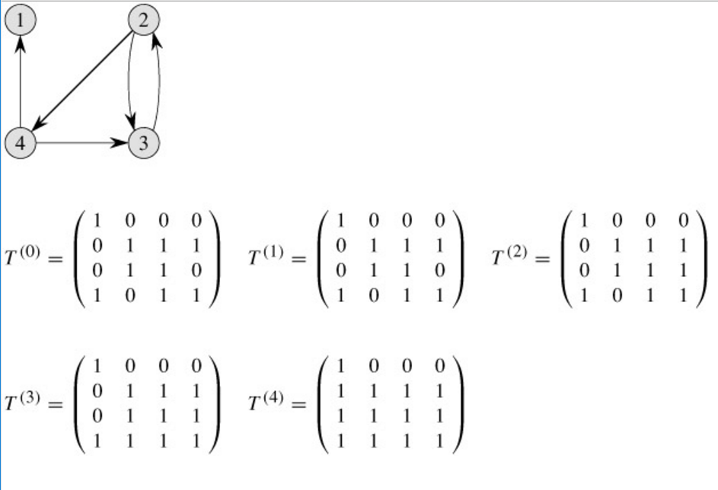
Graph algorithms
Warshall

Slide 90
Graph algorithms
Minimal spanning tree
A undirected graph is used to model symmetrical relations between vertices of the graph. Any arc (v,w) of an undirected graph is the same as the arc of (w,v).
A common task is to determine if for any pair of vertices, there is a path that connects them, in other words, if it is a connected graph

Slide 91
Graph algorithms
Minimal spanning tree
A minimal spanning tree is a subset of the graph that covers all vertices and which edges have a sum of the minimal weights
Applied on networks
A tree is a subset of the graph that is connected and has no cycles
If it has n vertices, then it has n-1 edges
There exists a unique path between any two vertices of a tree
If an edge is added it results in a cycle

Slide 92
Graph algorithms
Minimal spanning tree
If all vertices are on the tree, then it is a connected graph
Given undirected graph, find the minimal spanning tree

Slide 93
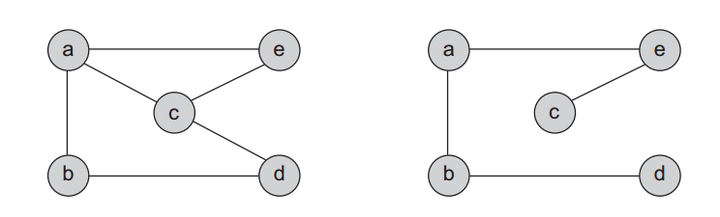
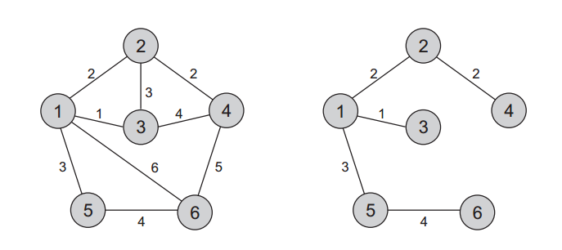
Graph algorithms
Minimal spanning tree

Slide 94
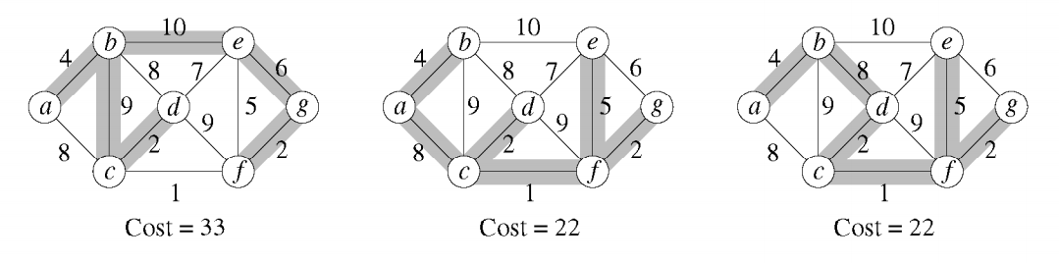
Graph algorithms
Minimal spanning tree
The same graph can have several spanning trees, but not all are the minimum

Slide 95
Graph algorithms
Minimal spanning tree
How to do this?
Prim algorithm
Kruskal algorithm

Slide 96
Graph algorithms
Prim
Grows the tree in successive stages. In each stage, one node is picked as the root, and we add an edge and the associated vertex to the tree
At any point we have a set of vertices that have been already included in the tree.

Slide 97
Graph algorithms
Prim
The algorithm finds a new vertex to add to the tree by choosing the edge (u,v) such as the cost of (u,v) is the smallest among all edges where u is in the tree and v not

Slide 98
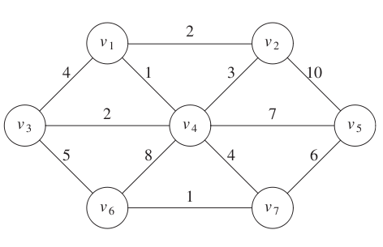
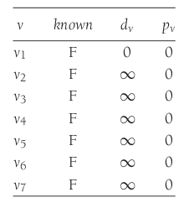
Graph algorithms
Prim
Minimum weight connecting to a known node

Slide 99
Graph algorithms
Prim

Slide 100
Graph algorithms
Prim
Last vertex that cause a change in d_{v}

Slide 101
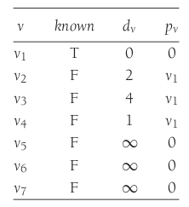
Graph algorithms
Prim

Slide 102
Graph algorithms
Prim
Next is the minimum

Slide 103
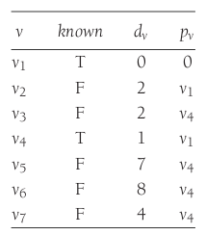
Graph algorithms
Prim

Slide 104
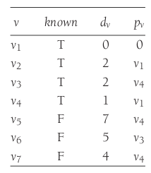
Graph algorithms
Prim

Slide 105
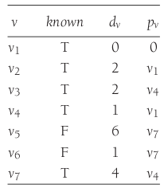
Graph algorithms
Prim

Slide 106
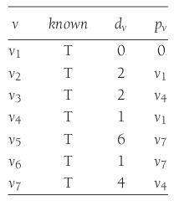
Graph algorithms
Prim

Slide 107
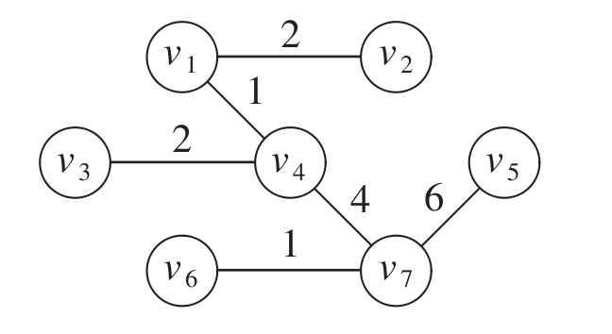
Graph algorithms
Prim

Slide 108
Graph algorithms
Kruskal
Selects edges if order of smallest weight and accept an edge if does not cause a cycle
Maintains a forest (collection of trees). Initially all are single node trees. Adding an edge merges two trees into one
If u and v are in the same set the edge (u,v) is rejected, because adding it would cause a cycle

Slide 109
Graph algorithms
Kruskal
u and v are in the same set if they are connected

Slide 110
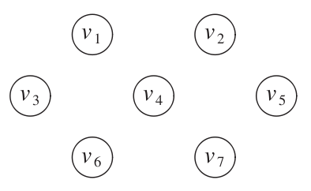
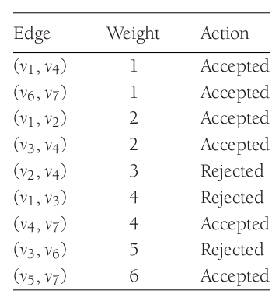
Graph algorithms
Kruskal

Slide 111
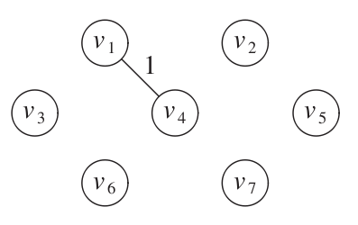
Graph algorithms
Kruskal

Slide 112
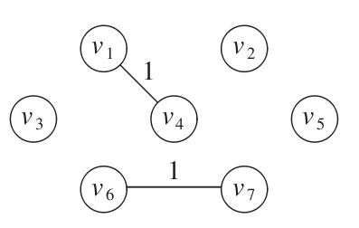
Graph algorithms
Kruskal

Slide 113
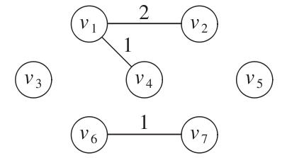
Graph algorithms
Kruskal

Slide 114
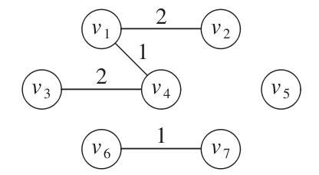
Graph algorithms
Kruskal

Slide 115
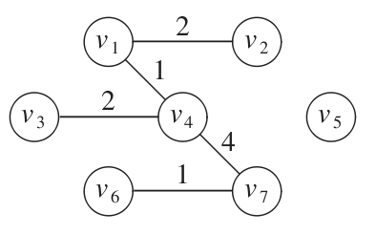
Graph algorithms
Kruskal

Slide 116
Graph algorithms
Kruskal

Slide 117
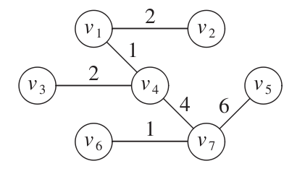
Graph algorithms
Kruskal

Slide 118
Graph algorithms
Kruskal

Slide 119
Graph algorithms
Kruskal

Slide 120
Graphs
CE-1103 Algorithms and Data Structures

